Slide 1
Diffusing Uncertainty of Diffusion-Weighted Imaging
Emma M. Tinney Northeastern University
Boston MA, United States
The Active Brain Special Interest Group

Slide 2
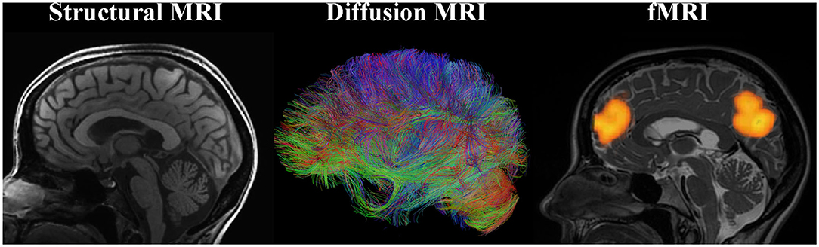
Overview of Brain
The Active Brain Special Interest Group
Notes:
So there are two main ways we can assess brain health: by looking at how the brain works—that’s brain function—and by looking at its physical makeup—that’s brain structure.
Within brain structure, we often hear about gray matter, which is where a lot of processing and decision-making happens. But today I want to focus on white matter, because that's where a lot of the most exciting research is happening, especially in the fields of exercise and sports science. Understanding white matter helps us understand how things like physical activity and training can shape the way our brains communicate—and ultimately how we think, move, and perform.

Slide 3
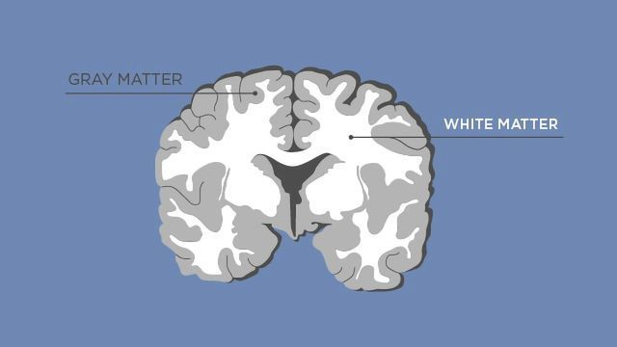
Overview of White Matter
The Active Brain Special Interest Group
Notes:
White matter is essentially just bundles of axons, while gray matter are groups of cell bodies that are connected to those axons. If the brain’s gray matter is where thinking happens, white matter is how those thoughts travel and connect different brain regions.

Slide 4

Overview of White Matter
The Active Brain Special Interest Group
Notes:
Imagine your brain as a big city. Just like a city needs roads and highways to connect different neighborhoods, your brain needs pathways to connect different areas so they can talk to each other. That’s what white matter does—it’s the brain’s communication network.
It helps you process information quickly.
It supports things like memory, attention, and coordination.
Damage to white matter—like from injury or disease—can make it harder for the brain to function smoothly.

Slide 5
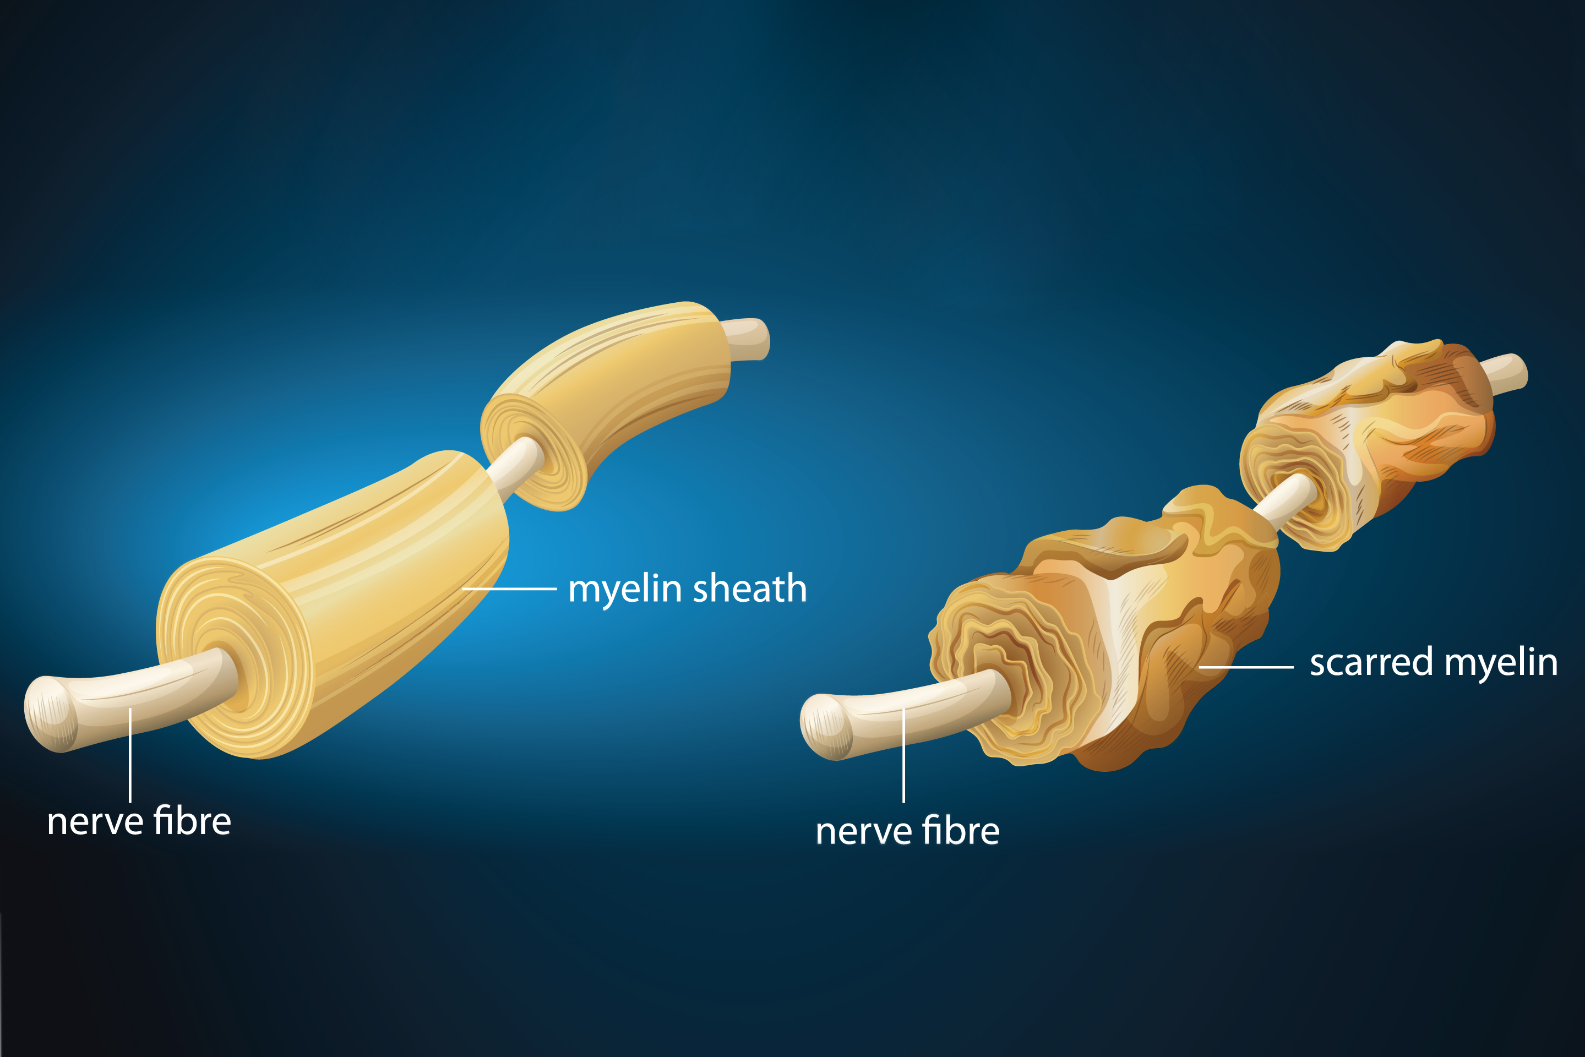
Overview of White Matter
Myelin degrades with age, interfering with signaling efficiency.
Increased myelination = increased white matter integrity
The Active Brain Special Interest Group
Notes:
Think of white matter like a system of high-speed tunnels connecting different parts of a city (your brain).
The tunnel itself is like the axon—a long pathway that carries messages between brain regions.
The cars and trucks moving through the tunnel are like the electrical signals or information being sent.
The concrete walls and safety features around the tunnel are like myelin—a protective layer that helps messages travel faster and more efficiently, just like how a smooth, well-built tunnel keeps traffic flowing without crashes or slowdowns.
If the tunnel is damaged, blocked, or crumbling, cars get stuck, delayed, or can’t make it through. In the same way, if white matter is injured (from things like trauma, disease, or aging), the brain’s messages can be slowed or disrupted—affecting how we move, think, or remember.

Slide 6

Overview of Diffusion-Weighted Imaging
How water moves in the brain
Water tends to move along the direction of nerve fibers
Maps white matter pathways and checks health and organization
Useful for studying how exercise, injury, or aging affect the brain
The Active Brain Special Interest Group
DWI gives us a noninvasive way to look inside the brain’s communication network
Notes:
To understand white matter, we need a type of brain scan called diffusion-weighted imaging, or DWI.
This scan doesn't look at what the brain looks like—it looks at how water moves inside the brain.
Water naturally moves around in the brain. In white matter, water tends to move along the direction of the nerve fibers. So if we track how water moves, we can get a picture of where those white matter pathways are and how healthy they might be.
What DWI Tells Us:
If water is moving smoothly in one direction, that usually means the white matter is organized and intact.
If water is moving randomly or unevenly, it might mean there's damage, inflammation, or changes in those pathways.
Imagine white matter like a highway, and water molecules like cars.
On a healthy, organized highway (good white matter), the cars mostly go in one direction, moving quickly and smoothly.
But if the highway is damaged—like after construction or an accident—the cars start going in all directions, or get stuck in traffic.
DWI helps us measure the quality and integrity of white matter. It’s especially useful in research on exercise, brain injury, aging, and mental health, because it shows us how experiences—like physical activity—can actually change the brain's wiring over time.

Slide 7
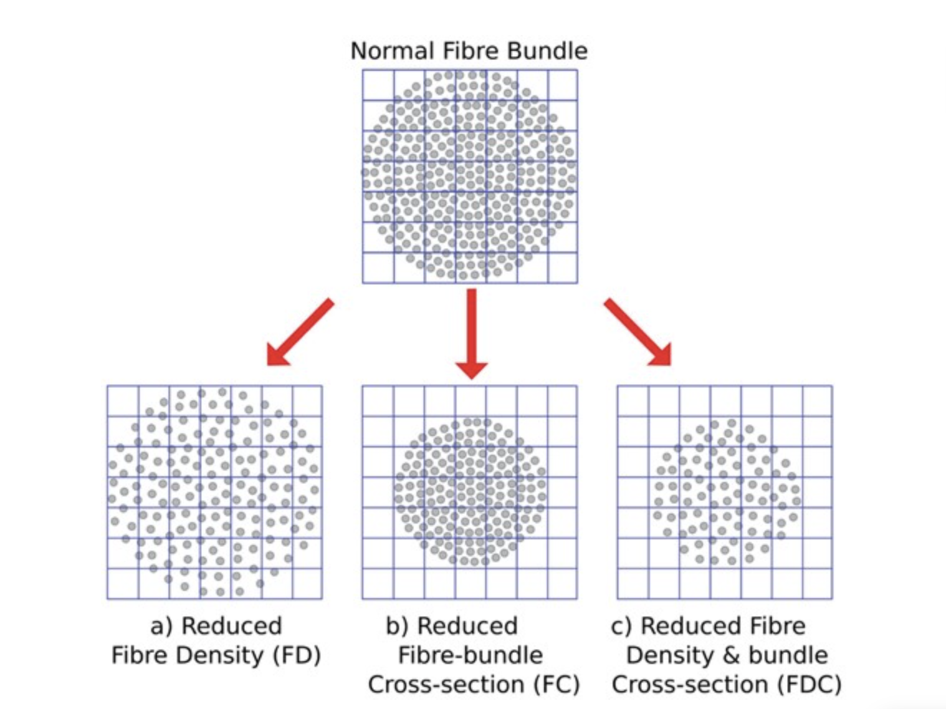
Advanced DWI Techniques
Diffusion Tensor Imaging
Fixel Based Analysis
The Active Brain Special Interest Group
Diffusional Kurtosis Imaging (DKI)
Neurite Orientation Dispersion and Density Imaging (NODDI)
High Angular Resolution Diffusion Imaging (HARDI)
Notes:
So most of the field of exercise and sports science uses dti. However, fixel based analyses are an advanced, and up and coming way to measure white matter in this field, these other three have not yet made a huge impact in the field just yet.

Slide 8
Diffusion Tensor Imaging
Fractional Anisotropy (FA): Directionality of water flow
↑ organized, myelinated tracts
↓ crossing fibers, demyelination, axonal loss
Mean Diffusivity (MD): Overall movement of water
↑ too much movement
↓ restricted movement
Axial Diffusivity (AD): Water movement along the wire
↑ Axonal damage
↓ healing or maturation of fibers
Radial Diffusivity (RD): Movement across across the wire
↑ demyelination
↓ myelination
The Active Brain Special Interest Group
Notes:
DTI is a special type of brain scan that builds on DWI by not only tracking how water moves, but also which direction it moves in white matter. This gives us more detailed information about the quality and condition of the brain's wiring.
1. Fractional Anisotropy (FA) – “How Directional is the Flow?”
Ranges from 0 to 1:
1 = water moves strongly in one direction (like a straight straw)
0 = water moves randomly (like in a puddle)
High FA = healthy, well-organized white matter
Low FA = problems like crossing fibers, damage, or loss of insulation
2. Mean Diffusivity (MD) – “How Much Movement is There Overall?”
Looks at how freely water moves, in all directions
High MD = too much movement (can mean swelling, inflammation)
Low MD = restricted movement (can happen in some injuries or diseases)
3. Axial Diffusivity (AD) – “Movement Along the Wire”
Measures water moving along the main direction of the fiber
Low AD = may suggest maturing or healing of fibers
High AD = could point to damage inside the axon itself
4. Radial Diffusivity (RD) – “Movement Across the Wire”
Measures water moving across the fiber, not along it
High RD = possible demyelination (loss of the insulation around the wire)
Low RD = suggests healthy or increasing myelination

Slide 9
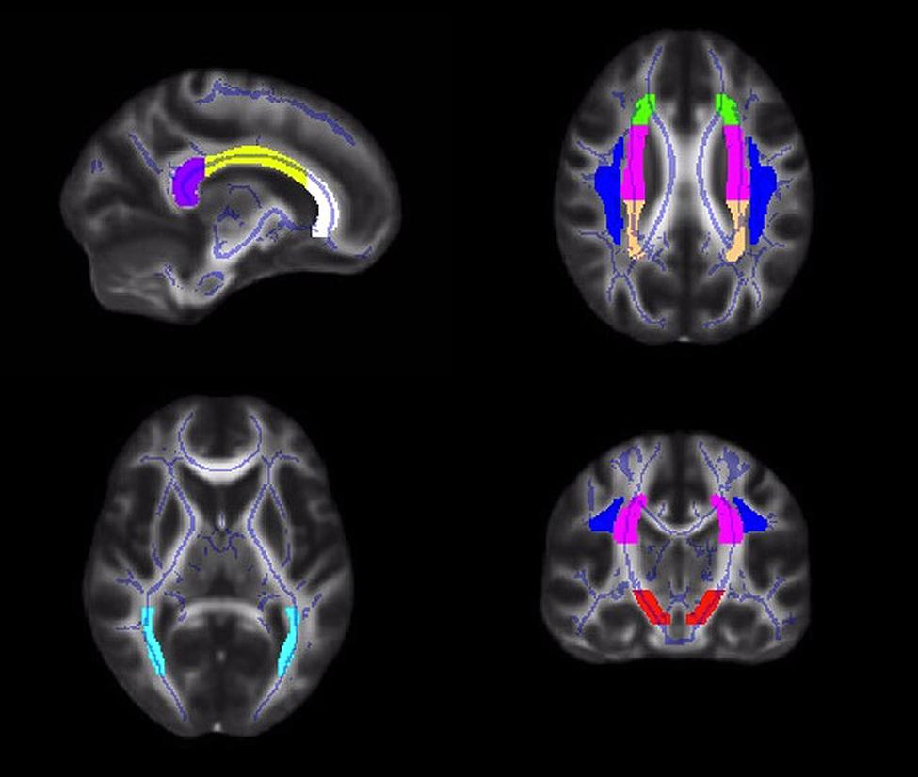
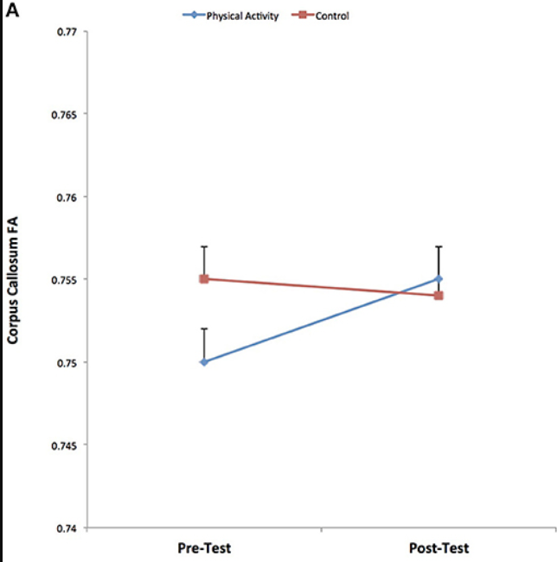
Diffusion Tensor Imaging
The Active Brain Special Interest Group
Chaddock-Hayman et al (2014, 2018)
Notes:
My lab has done a lot of the work in the field of DTI and exercise. These are examples in children, and theres a lot more work in older adutls. Cross sectional work shows Higher fit 9- and 10-year-old children showed greater white matter integrity compared to lower fit children. Later, this same work showed that diffusion metrics predicted academic performance 1 year late. Intervention work shows that physical activity can improve WM microstructure.

Slide 10
Fixel Based Analysis
Fiber Density - how many axons are packed into a specific fiber bundle
↑ more axons
↓ fewer axons
Fiber Cross Section- Size of the fiber bundle
↑ wide, healthy bundle
↓ shrinking bundle
Fiber Density and Cross Section - Combines both density and size
↑ lots of axons in a wide bundle
↓ reduced fibers or bundle size or both
The Active Brain Special Interest Group
Raffelt et al 2017
Notes:
Fixel-based analysis is a more advanced way to study white matter. Instead of looking at whole regions, it zooms in and separates out individual fiber populations—even when they cross or overlap in the same spot.
Think of it like zooming into the map and analyzing each street separately.
Fiber Density (FD) –
Looks at how many axons are packed into a specific fiber bundle
High FD = more axons (healthy, dense communication wires)
Low FD = fewer axons (may mean axonal loss or degeneration)
2. Fiber Cross-Section (FC) –
Measures the size of the fiber bundle itself
High FC = a wide, healthy bundle
Low FC = the bundle is shrinking (possibly from atrophy or underdevelopment)
3. Fiber Density and Cross-Section (FDC) –
Combines both density and size
High FDC = strong, healthy wiring (lots of axons in a wide bundle)
Low FDC = signs of reduced brain wiring health, either from inside the fibers (micro) or the bundle size itself (macro)

Slide 11
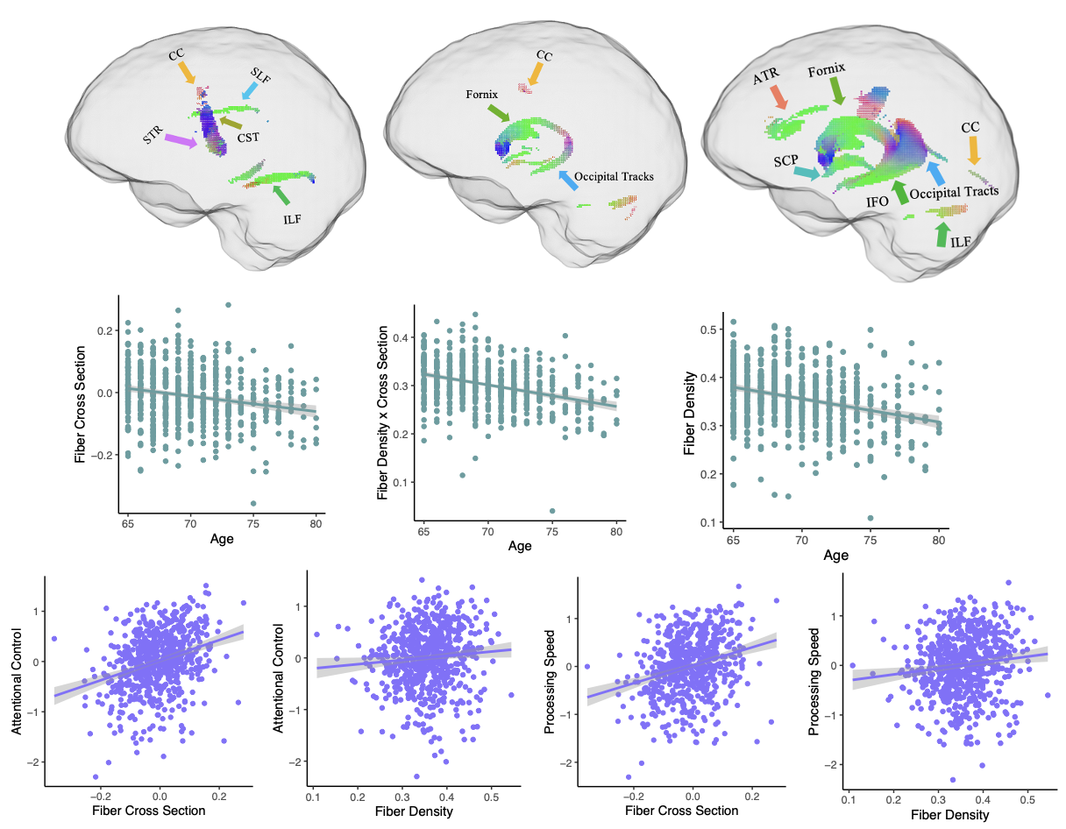
Fixel Based Analysis
The Active Brain Special Interest Group
Tinney et al (2024) Human Brain Mapping
Notes:
Some of my work has extended the work in our lab, extending the work from DTI to fixels. We see decreased white matter integrity are associated with increased age. Moreover, increased integrity in these tracks were associated with better processing speed, attentional control, and working memory
However, see my talk later for more on cardiorespiratory fitness and fixel based analyses

Slide 12


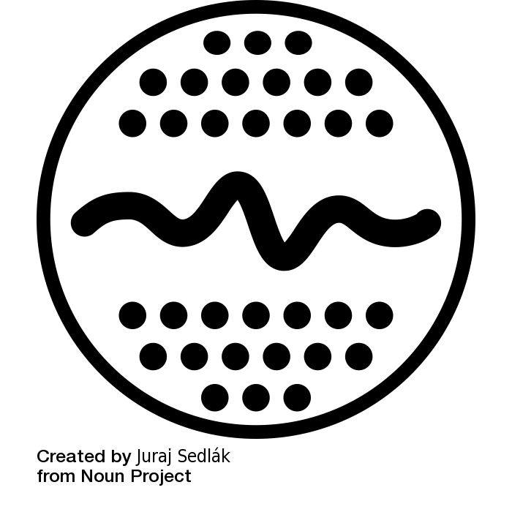



Sources of Uncertainty in DWI
Technical Challenges
Participant-related factors
Motion artifacts
Hydration status
The Active Brain Special Interest Group
Signal-to-noise limitation
Recent exercise
Scanner variability
Participant Demographics
Notes:
Technical challenges:
Motion artifacts: "Even subtle head movement can significantly distort diffusion measurements”
StN "Lower SNR than conventional MRI, particularly at higher b-values”
Scanner variability: "Cross-site and cross-scanner comparisons remain problematic”
Hydration status: "Can alter diffusion measurements by 5-8% in white matter”
Recent exercise: "Acute effects on cerebral blood flow impact diffusion parameters”
age: sex, socioeconomic status, BMI, can impact associations in white matter

Slide 13






Reducing Uncertainty
Protocol Optimization
Participant Preparation
Multi-shell Acquisitions
Standardized Hydration Protocol
The Active Brain Special Interest Group
Cardiac Gating
24-Hour Exercise Abstention
Balanced Signal to Noise Ratio
Head Stabilization Techniques
Notes:
"Multi-shell acquisitions improve model fitting and reduce uncertainty"
"Cardiac gating, or synching data acquisition with the heart's cardiac cycle, minimizes pulsation artifacts in brainstem and cerebellar regions"
"Shorter TR/TE balances SNR with scan time constraints”
"Standardized hydration protocols reduce variability
"24-hour exercise abstention before scanning for baseline measurements"
"Head stabilization techniques, such. As foam pads or bite bars, reduce motion artifacts by 30-40%"

Slide 14
Applications in Sports Science
Brain plasticity assessment following exercise interventions
Monitoring recovery from sports-related concussion
Evaluating white matter integrity in relation to skill acquisition
Measuring exercise-induced neuroplasticity across the lifespan
The Active Brain Special Interest Group
Schaeffer et al 2014
Cubon et al 2018
Schultz et al 2014
Islam et al 2019
Notes:
Theres many applications for dwi in sports science
We have assessed brain plasticity following exercise interventions
Evaluating white matter integrity in relation to skill acquisition.
Monitoring recovery from sports-related concussion,
Measuring exercise-induced neuroplasticity across the lifespan.

Slide 15



Thank you!
Diffusion Resources
Oral Presentation July 3rd 10am, Tempio 2
Notes:
Thank you for listening, please see my talk tomorrow morning at 10am for some exciting fixel and fitness results in older adults
you can find some diffusion resources on my website and feel free to reach out with questions!

